Slide 2
Simulated-Annealing Intuition
x = randnumberbetween ([0 1])
If x > t, choose best operator, else choose random operator
If we set t to be 0, this is pure greedy search
If we set t to be 1, it is pure random search
If we set t to be in-between 0 and 1, it is partly random/partly greedy search. t stands for temperature
Here is the whole idea
Start the search with a high value of t, then slowly lower the temperature of to zero
In other words, start with pure random search, then slowly make it pure greedy search
When the algorithm is “young” it explores wildly, as it gets “older:, it becomes more conservative, and more likely to move in the direction of improvement

Slide 3
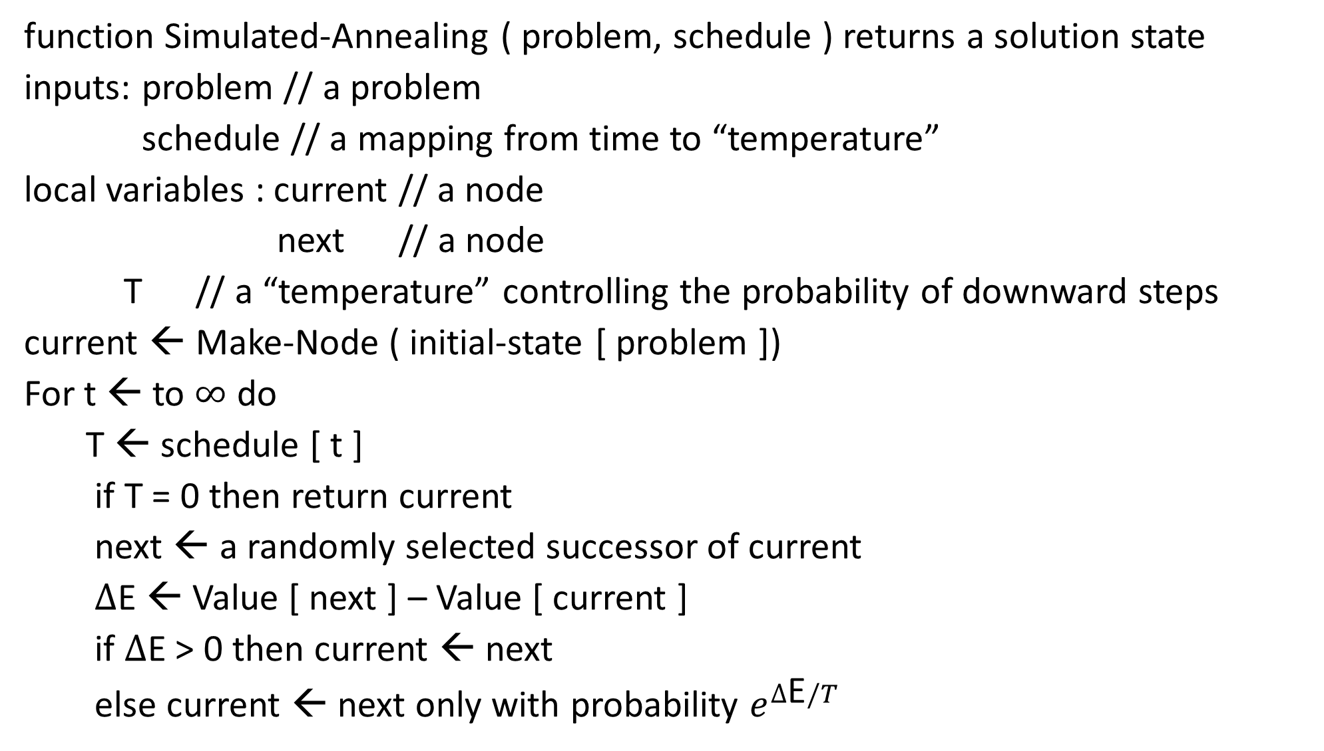
function Simulated-Annealing ( problem, schedule ) returns a solution state
inputs: problem // a problem
schedule // a mapping from time to “temperature”
local variables : current // a node
next // a node
T // a “temperature” controlling the probability of downward steps
current ← Make-Node ( initial-state [ problem ])
For t ← to $∞$ do
T ← schedule [ t ]
if T = 0 then return current
next ← a randomly selected successor of current
$∆$E ← Value [ next ] – Value [ current ]
if $∆$E > 0 then current ← next
else current ← next only with probability $e^{∆\text{E}/T}$

Slide 4

When the temperature is 25, we are doing pure random search
When the temperature is 12.5, we are doing a 50/50 mix random/greedy search
When the temperature is zero, we are doing pure greedy search
(most folks have the temp normalized between 1 and 0, this nice gif does not)
https://upload.wikimedia.org/wikipedia/commons/d/d5/Hill_Climbing_with_Simulated_Annealing.gif

Slide 5
Simulated-Annealing
It is possible to determine the rate at which t should go to zero, to have an optimal solution
However, it is generally much too slow to use that rate
So, in practice, you pick a time budget, say one hour.
And you let the t go from 0 to 1 in one hour
This is not optimal, but tends to work very well in practice

Slide 6

Genetic Algorithms I (R and N, pages 619-621)
Variation (members of the same species are differ in some ways)
Heritability (some of variability is inherited)
Finite resources (not every individual will live to reproductive age)
Given the above, the basic idea of natural selection is this:
Some of the characteristics that are variable will be advantageous to survival. Thus, the individuals with the desirable traits are more likely to reproduce and have offspring with similar traits
And therefore the species evolve over time…

Slide 7
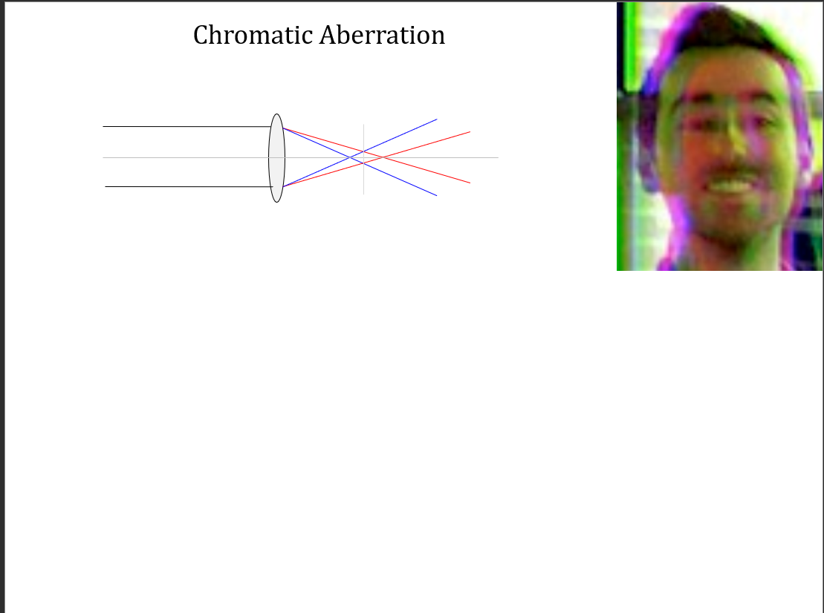

Slide 8
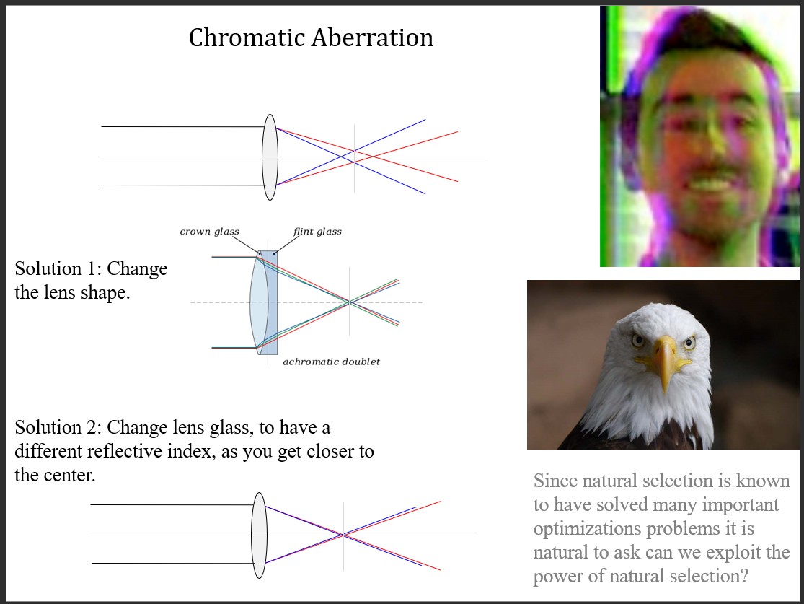

Slide 9
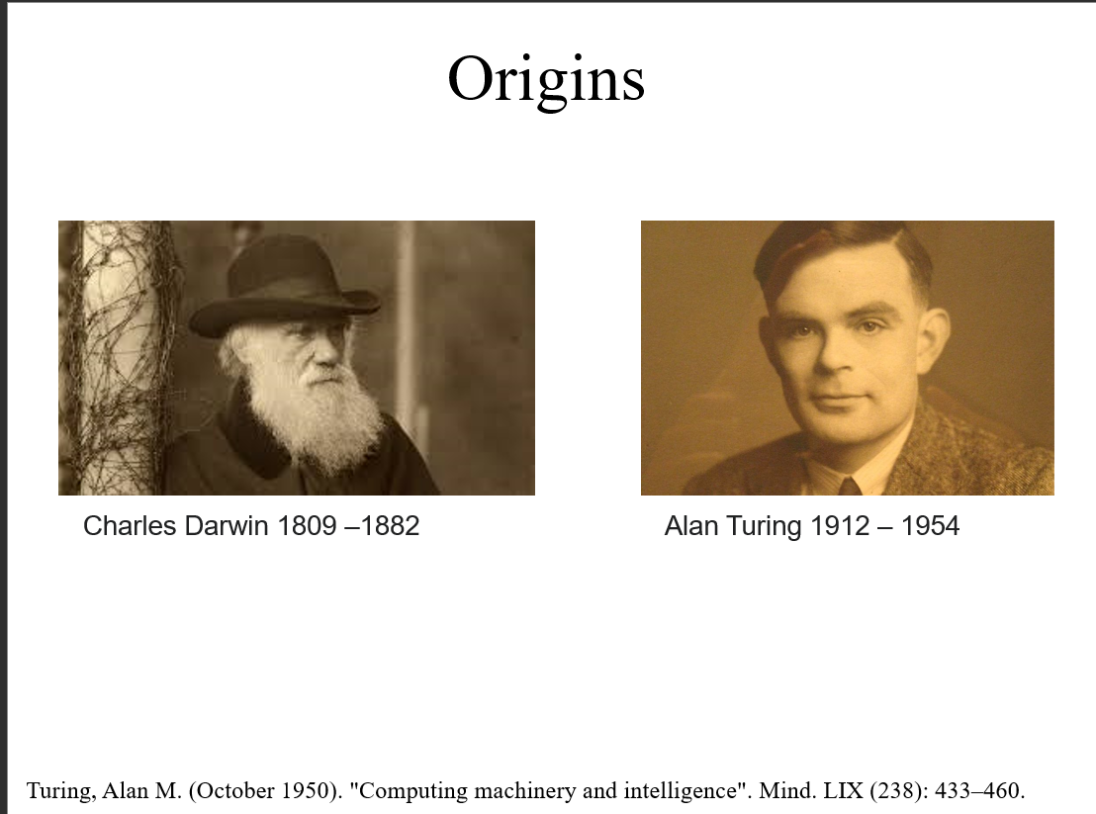

Slide 10
Genetic Algorithms II
The basic idea of genetic algorithms (evolutionary programming).
Initialize a population of n states (randomly)
While time allows
Measure the quality of the states using some fitness function.
“kill off” some of the states.
Allow the surviving states to reproduce (sexually or asexually or..)
end
Report best state as answer.
All we need to do is… (A) figure out how to represent the states. (B) Figure out a fitness
Function. (C) Figure out how to allow our states to reproduce (operators)

Slide 11
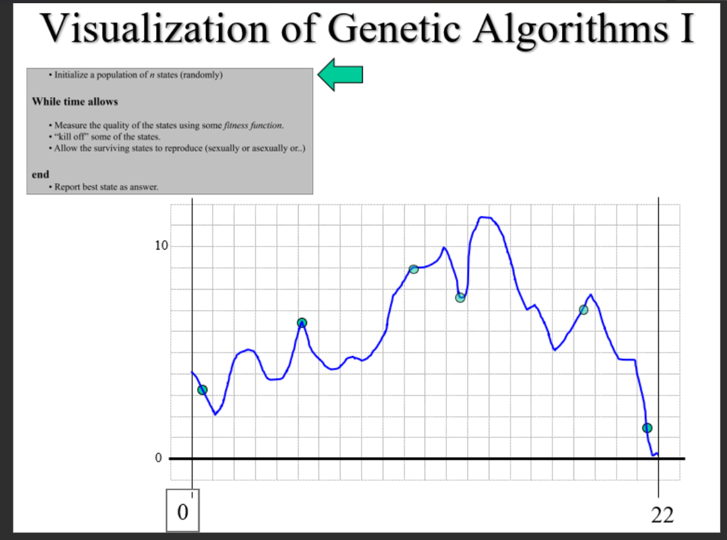

Slide 12
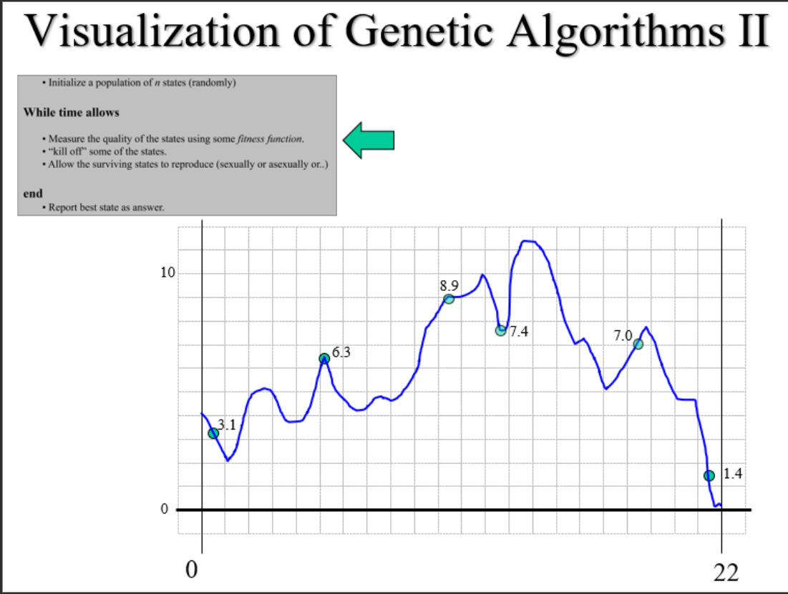

Slide 13
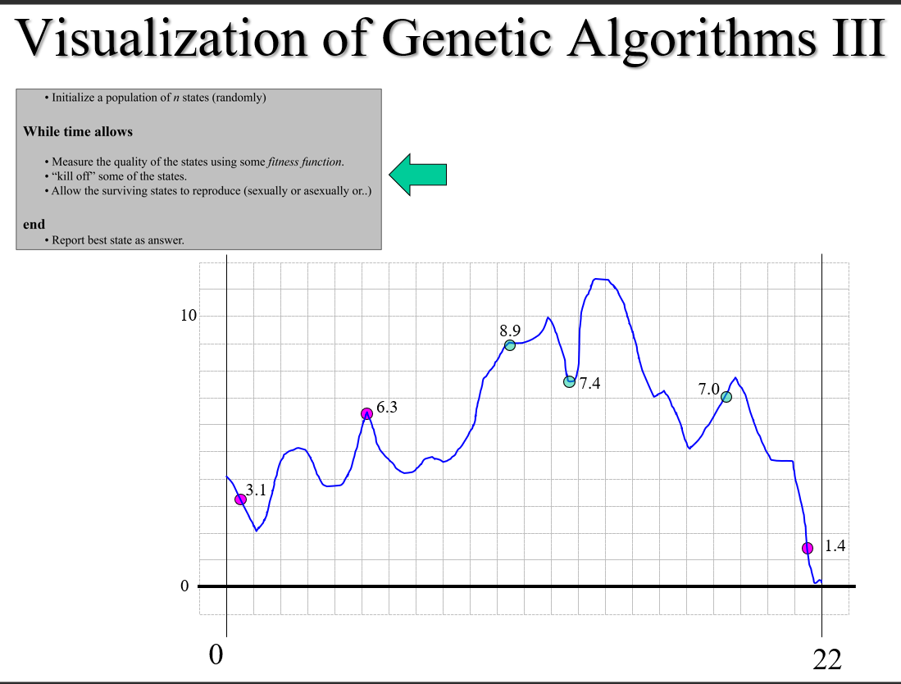

Slide 14
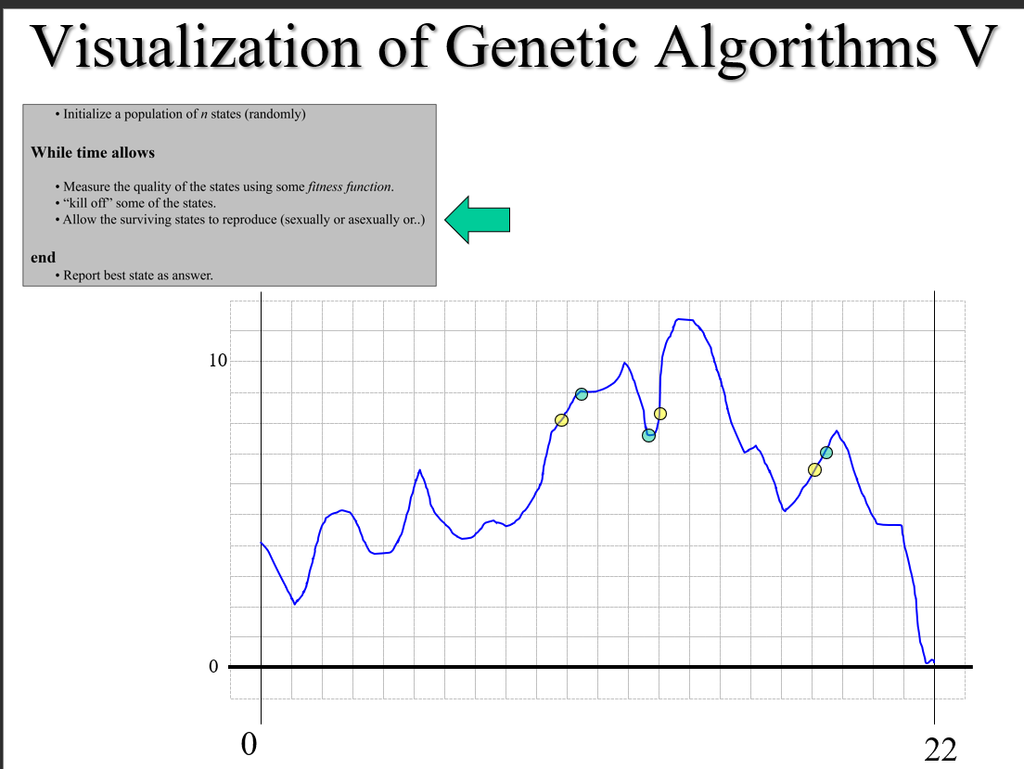

Slide 15
Genetic Algorithms III
log(x^{y}) + sin(tan(y-x))
One possible representation of the states
In a tree structure…
(in GA, states are often called genomes)
For problems where we are trying to
Find the best order to do some thing
(TSP), a linked list might work…
+
log
sin
Another is a bitstring
100111010101001
pow
tan
x
y
-
y
x
A
C
E
F
D
B
A

Slide 16
Genetic Algorithms IV
+
Usually, the fitness function is fairly trivial
For the function maximizing problem we can evaluate the given function with the state (the values for x,y,z,… etc)
For the function finding problem we can evaluate the function and see how close it matches the data
For TSP the fitness function is just the length of the tour represented by the linked list
log
sin
pow
tan
x
y
-
y
x
A
C
E
F
D
B
A

Slide 17
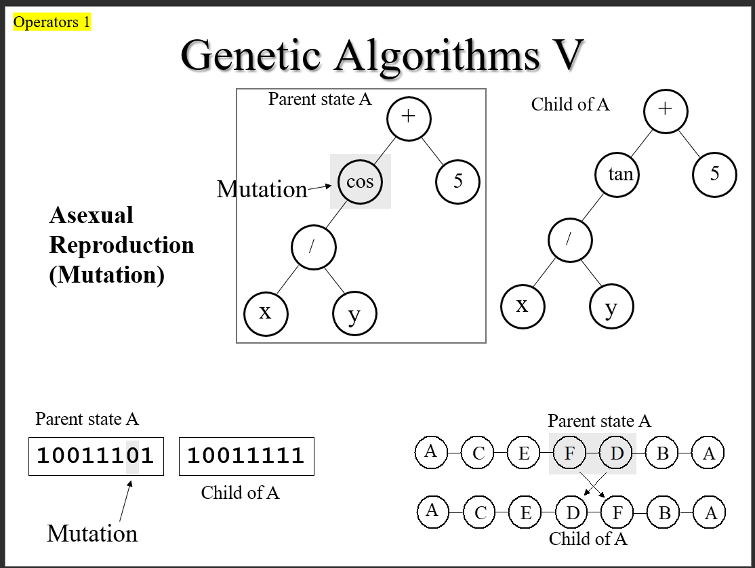

Slide 18
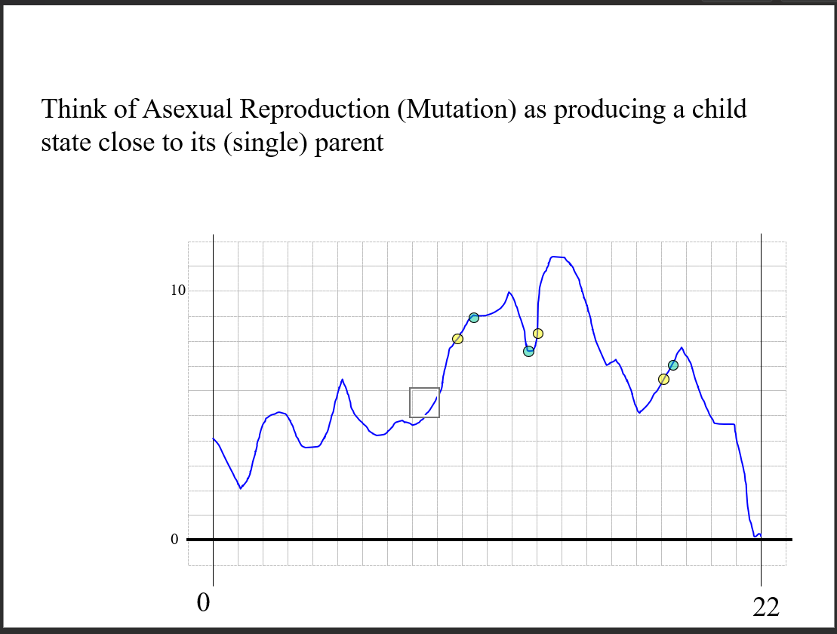

Slide 19
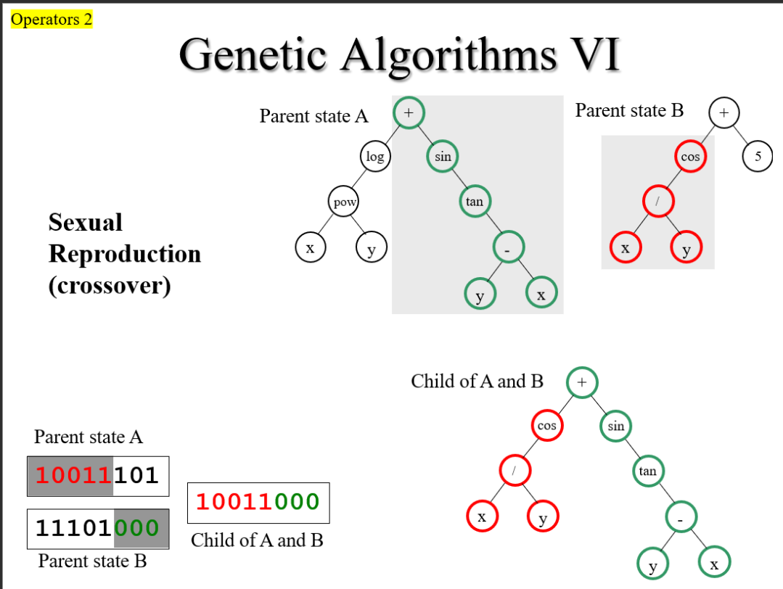

Slide 20
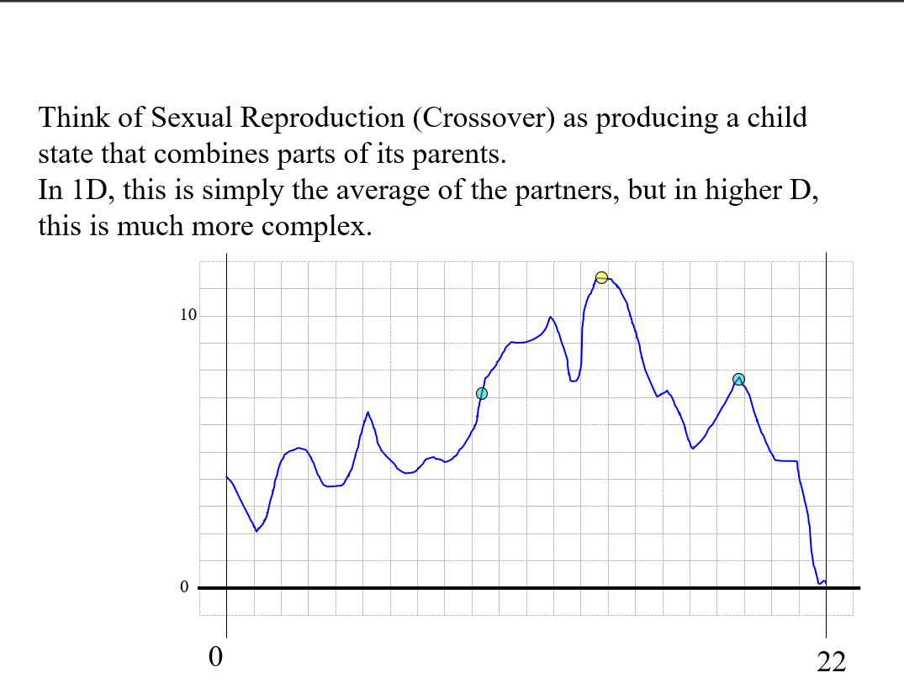

Slide 21
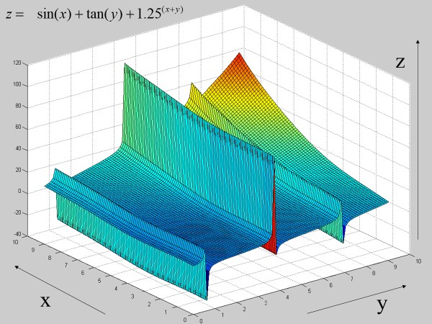
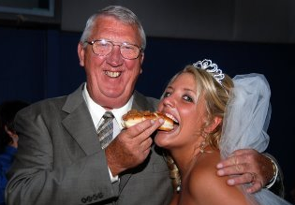
Suppose you had states A and B…
A child that had A’s Y value and B’s X value would be awful.
A child that had A’s X value and B’s Y value would be great.
This happens in nature, consider…
A child that had his looks and her ability to earn money.
vs
A child that had his ability to earn money and her looks.

Slide 22
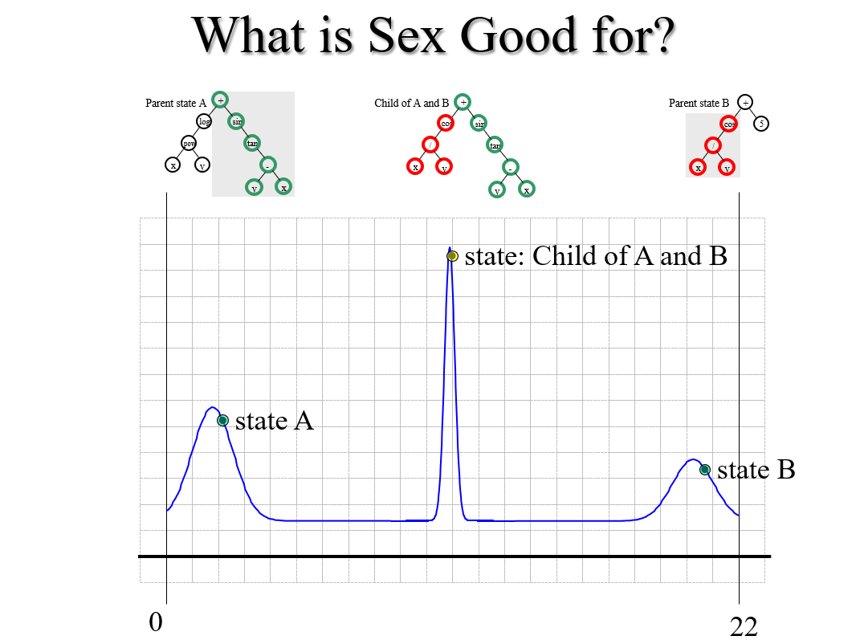

Slide 23
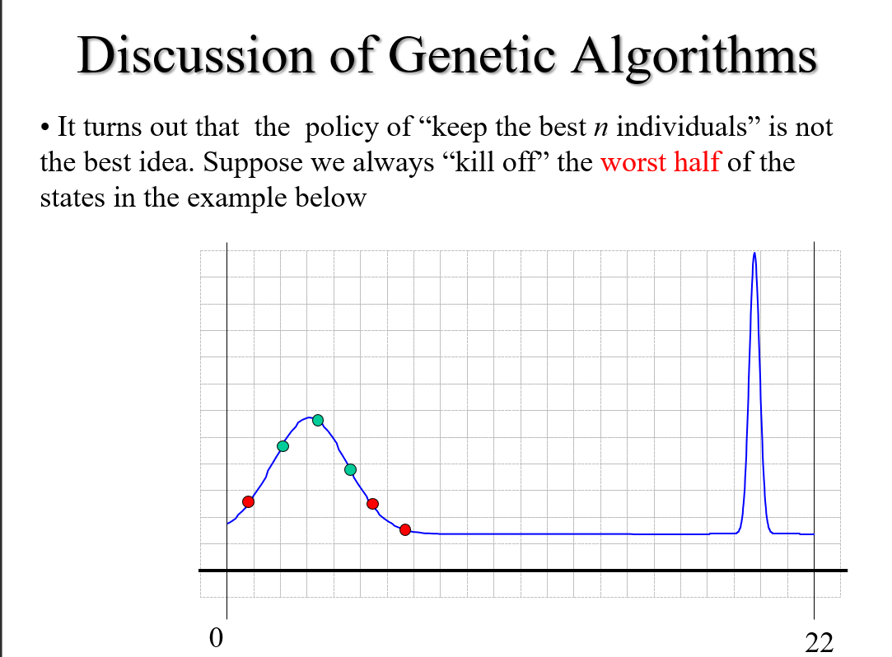

Slide 24
Discussion of Genetic Algorithms
Genetic Algorithms require many parameters… (population size, fraction of the population generated by crossover; mutation rate, number of sexes…) How do we set these?
Genetic Algorithms are really just a kind of hill-climbing search, with some randomness but seem to have less problems with local maximums
Genetic Algorithms are very easy to parallelize…
Applications:
Protein Folding, Circuit Design, Job-Shop Scheduling Problem, Timetabling, designing wings for aircraft

Slide 25
Genetic Algorithm Success Story
For an antenna for a particular job, we can measure its fitness by…
A straight antenna gives some fitness, but bending it in different locations can give you different fitness.
We can define a state, (not shown, say a linked list of “bends”)
We define operators
forward(length, radius) Add a wire with the given length and radius extending from the current location and then change the current state location to the end of the new wire
Rotate-x(angle) Change the orientation by rotating it by the specified amount (in radians) about the x axis
Rotate-y(angle) Change the orientation by rotating it by the specified amount (in radians) about the y-axis
Rotate-z(angle) Change the orientation by rotating it by the specified amount (in radians) about the z-axis

Slide 26
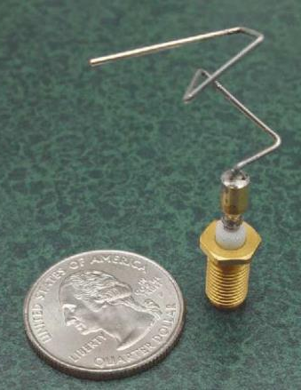
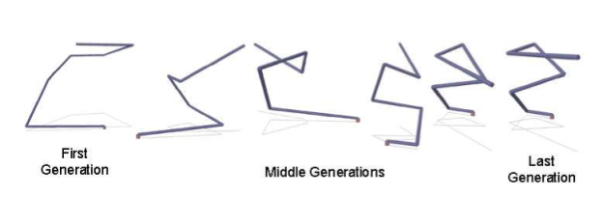
Genetic Algorithms First Computer Evolved Hardware in Space

Slide 27
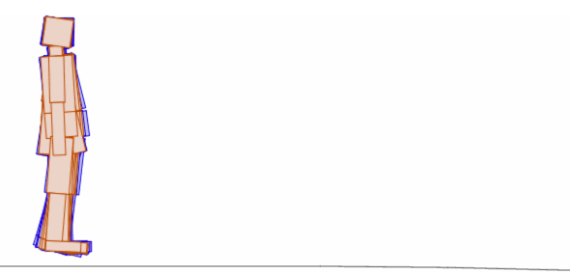
A great way to kill time
http://rednuht.org/genetic_walkers/

Slide 28
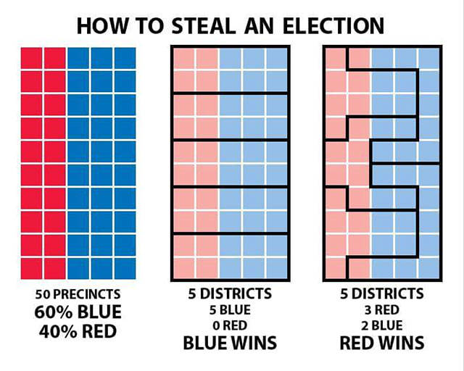
Sample Optimization Problem
Here we have a state which is divided into 50 percents
We have the task of assigning 5 districts of equal sizes
The overall election is decided by who wins the most districts
If, instead, the party that captured the most precincts won, this state would go to the blue party.
Popular vote.

Slide 29
Sample Optimization Problem
For a sensible assignments of five districts, the blue party does win.
All precincts in a districts must be connected.

Slide 30
Sample Optimization Problem
However, we can search for assignments of the five districts such that red wins!
This is called Gerrymandering
One basic idea of Gerrymandering, try to have just one or two districts that concentrate almost all of your rival

Slide 31
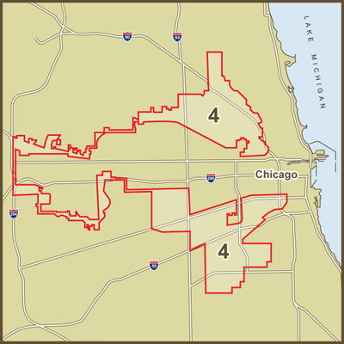
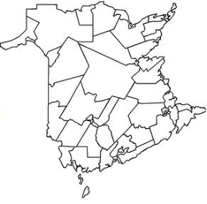
Sample Optimization Problem
Here is a real-world example
We could frame Gerrymandering as an optimization problem
What would be the initial state?
What are the operators?
What is the evaluation function?
Gerrymandered 4th Congressional District in Illinois

Slide 32
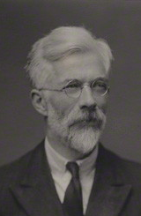
Why are Humans so Smart?
Basic idea of runaway evolution due to Ronald Fisher (whom we will meet as the inventor of the linear classifier)
Application to human intelligence mostly due to Geoffrey Miller
Geoffrey Miller The Mating Mind: How Sexual Choice Shaped Human Nature (2000)
This is a theory, but very plausible
Ronald Fisher

Slide 33

1.5 inch tail
I like guys with a two inch tail..
2 inch tail
2.5 inch tail
Sexual selection is a big driver of evolution
The tails of a bird are control by genes, but critically, so is their behavior
Female choice is an example of a behvaior. If a female that likes 20inch tails has daughters, it is likely that the daughters will also like 2-inch tails
Some female choice may be rational, they may choose for strong beaks, or for good nest making ability, or ….
Some (perhaps most) female choices could be arbitrary

Slide 34
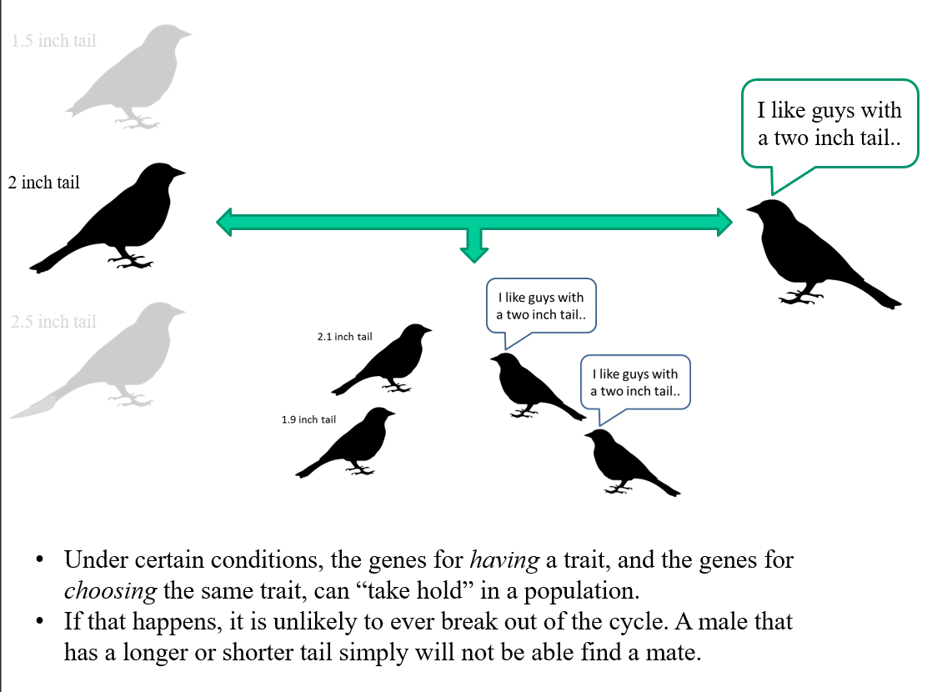

Slide 35
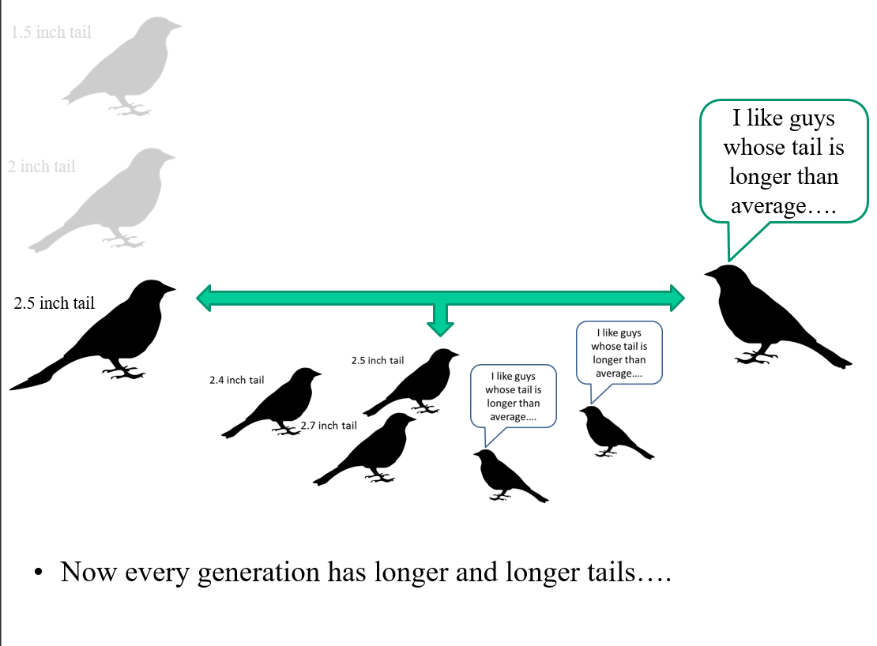

Slide 36
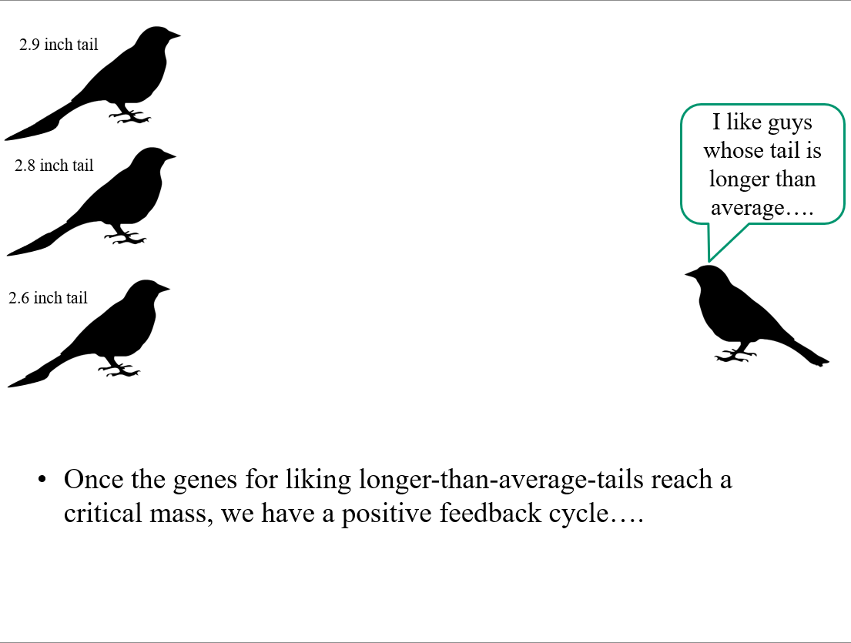

Slide 37
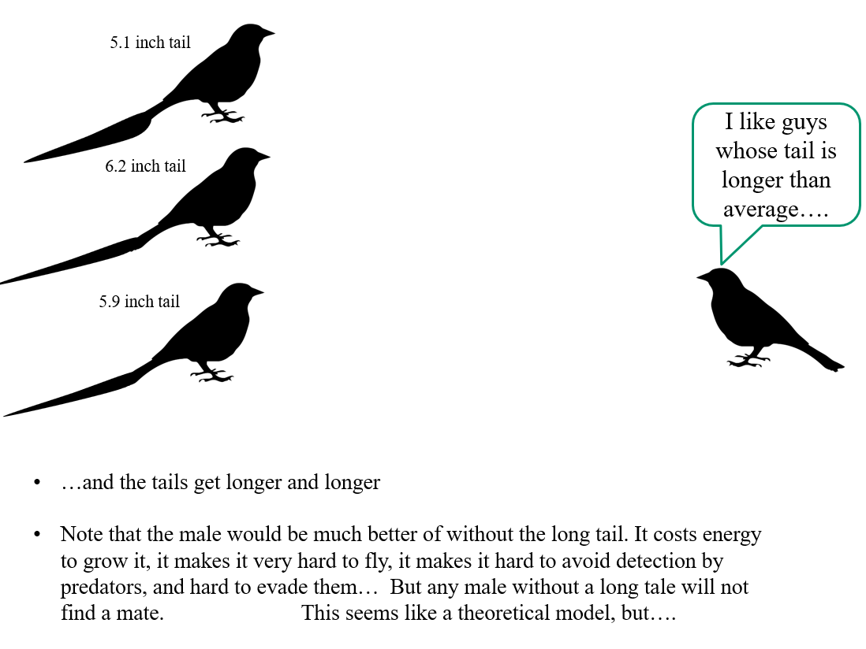

Slide 38
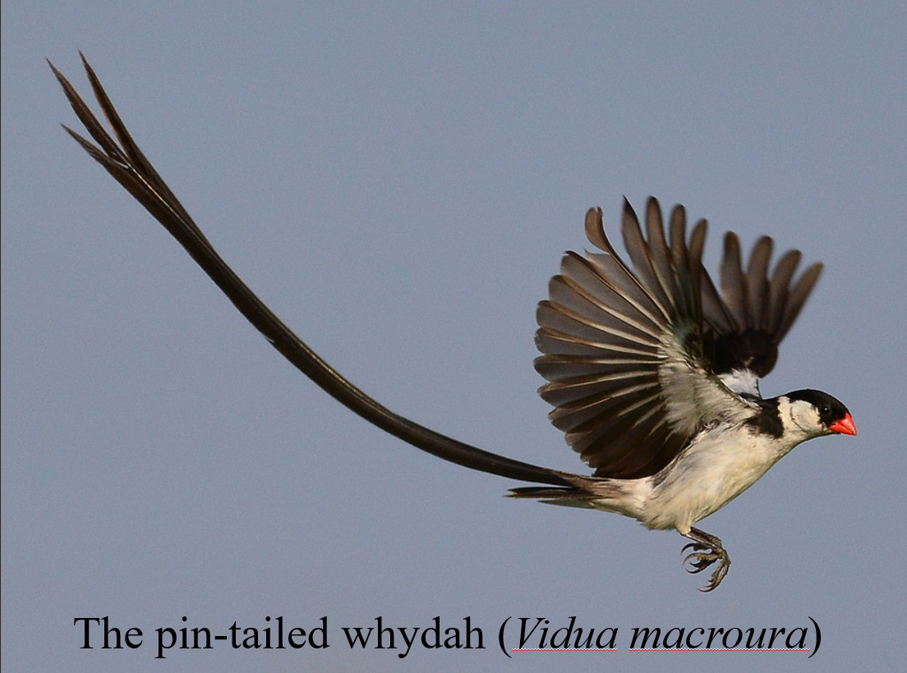

Slide 39
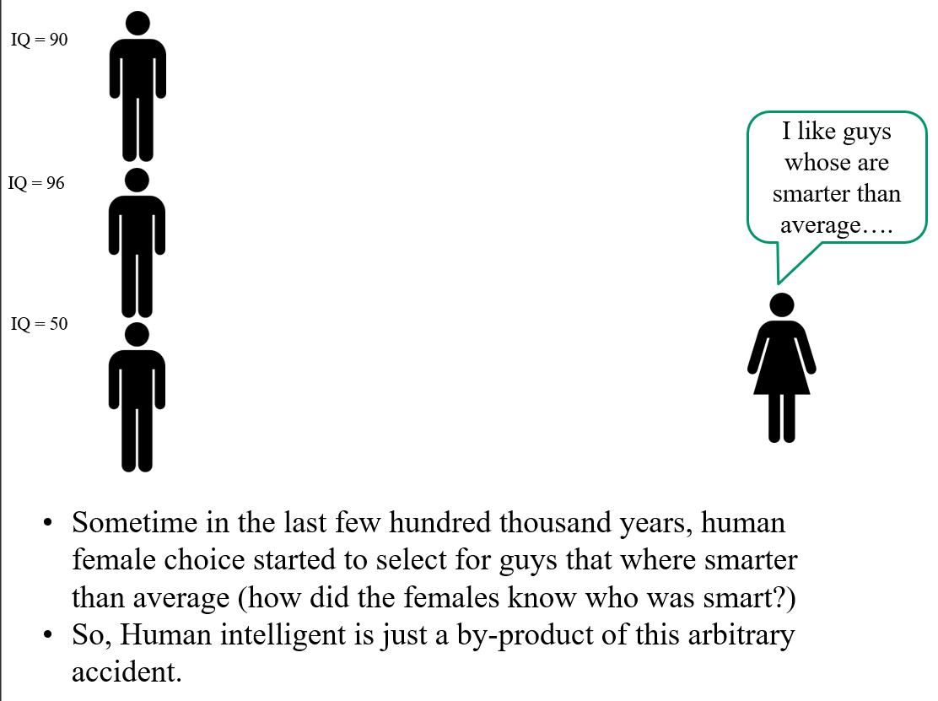

Slide 40


Slide 41
Random Search Revisited
Random Search can solve the Rubik Cube!
If I take a scrambled cube, and randomly rotate a side, eventually I will solve it.
How many moves will it take on average?

Slide 42
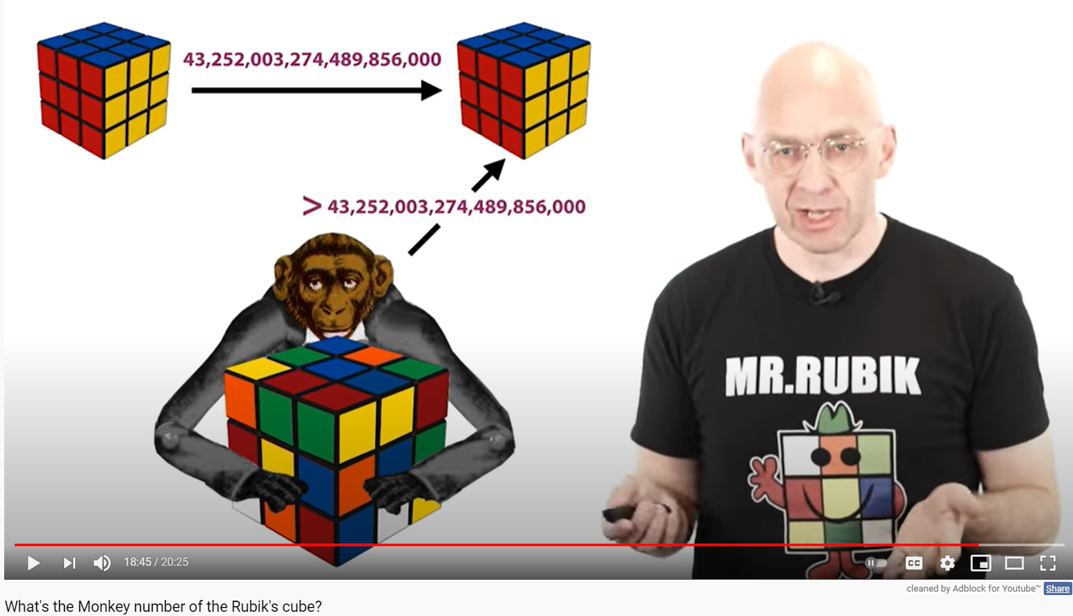
Random Search Revisited
Random search can solve the Rubik Cube!
If I take a scrambled cube, and randomly rotate a side, eventually I will solve it
How many moves will it take on average?
Slightly more than
43,252,003,274,489,856,000
https://www.youtube.com/watch?v=vYEhCiP96Hg&ab_channel=Mathologer

